Slide 1
Improving Conversational Analytics of a Voice-Based Digital Assistant for Geriatric Care
24.07.2023, Bachelor’s Thesis Final Presentation
Nicolas Klein

Slide 2
Outline
Introduction
  Motivation
  Technical Foundations
Research Approach
  Research Questions
  Methodology
Results
  Literature Analysis
  Semi-Structured Interviews
  Log Data Analysis and Visualization
Improvement Suggestions
Conclusion

Slide 3



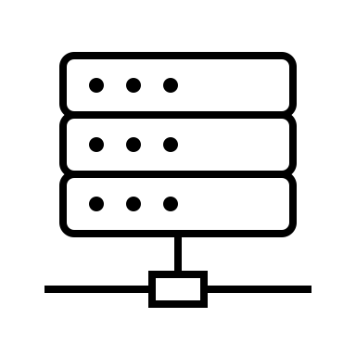


Motivation
Two Trends
Global staff shortage in the elderly/medical care sector
Major advancements in the fields of AI and NLP
WHO: Shortfall of 10 million healthcare workers worldwide in 2030
Utilize modern technology in this sector
WHO - Healthcare staff shortage (https://www.who.int/health-topics/health-workforce/)

Slide 4
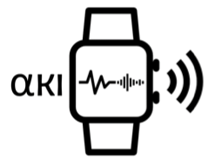

Technical Foundations
ALPHA-KI Research Project
  Voice-based digital health assistant for elderly & chronically ill people
  Comes embedded in a smartwatch & a stationary smart speaker
  First Rollout: Q4 2022, currently around 30 users
  Built on Google’s NLU platform “Dialogflow"
Agent’s Tasks
  Track vital signs of the patient
  Warn about irregularities & call emergency services
  Medication & hydration intake control
  Casual & informative features
→ Currently no analytics solution used!
ALPHA-KI Research Project (https://wwwmatthes.in.tum.de/pages/uysghltybqze/AI-Based-Digital-Health-Assistant-ALPHA-KI)
Dialogflow (https://cloud.google.com/dialogflow)

Slide 5
Technical Foundations
CDD Cycle
Conversation Driven Development (CDD)
  Best practice for developing conversational AI assistants
  Repeating and non-linear cycle
  Principle: Listen to your users and how they interact with the system → adapt the system → repeat
  Focus of this work: Data Analysis of the ALPHA agent (review log-data, track behavior, prepare “Fix” phase)
Share
Fix
Review / Annotate
Test & Track Behavior
RASA Docs on CDD (https://rasa.com/docs/rasa/conversation-driven-development/)

Slide 6
Outline
Introduction
  Motivation
  Technical Foundations
Research Approach
  Research Questions
  Methodology
Results
  Literature Analysis
  Semi-Structured Interviews
  Log Data Analysis and Visualization
Improvement Suggestions
Conclusion

Slide 7
Research Questions
RQ1
What are current insights from literature into “Conversational Analytics” and “Conversation Driven Development” of conversational agents?
RQ2
How can insights from literature and expert interviews help to build a conversation analytics tool, and how can this be supportive in uncovering strengths and weaknesses of the digital assistant for geriatric care?
RQ3
What are feasible improvements of the agent and how could they work?

Slide 8
Methodology
Literature Analysis
Log Data Processing & Analysis
Dashboard Development
(1. Iteration)
Semi-structured Expert Interviews
Continued
Dashboard Development

Slide 9
Methodology
RQ1
What are current insights from literature into “Conversational Analytics” and “Conversation Driven Development” of conversational agents?
→ Literature Analysis
Used Libraries: IEEE Xplore, ACM Digital Library, Scopus (timeframe: 2018 – Q1 2023)
Initial Selection Criteria: Combination of (conversational) data analysis with a type of digital assistant
Backward Search (Keywords & Papers)
→ Search resulted in 16 relevant papers
Reading full texts
Nine papers to be explored in detail
Seven papers to be considered in short

Slide 10
Methodology
RQ2
How can insights from literature and expert interviews help to build a conversation analytics tool, and how can this be supportive in uncovering strengths and weaknesses of the digital assistant for geriatric care?
→ Semi-Structured Expert Interviews
Five interview partners (contributors to the ALPHA project → developers, testers, etc.)
Semi-structured style (online, 15-20mins, no recording, German)
Question Catalog for loose orientation (usage/metrics of log data & data visualization)
→ Log Data Analysis & Visualization
Analyze raw Dialogflow log files & process data for further usage
Determine framework, graphs, and interaction possibilities for the dashboard prototype

Slide 11
Methodology
RQ3
What are feasible improvements of the agent and how could they work?
→ Apply gained knowledge and prototype features
Analysis of typical approaches in the literature → Applicability for the ALPHA agent?
Use insights from the interviews
Apply the developed prototype features to dissect the agent’s behavior and struggles
→ Suggest ideas for improvements that could be realized

Slide 12
Outline
Introduction
  Motivation
  Technical Foundations
Research Approach
  Research Questions
  Methodology
Results
  Literature Analysis
  Semi-Structured Interviews
  Log Data Analysis and Visualization
Improvement Suggestions
Conclusion

Slide 13
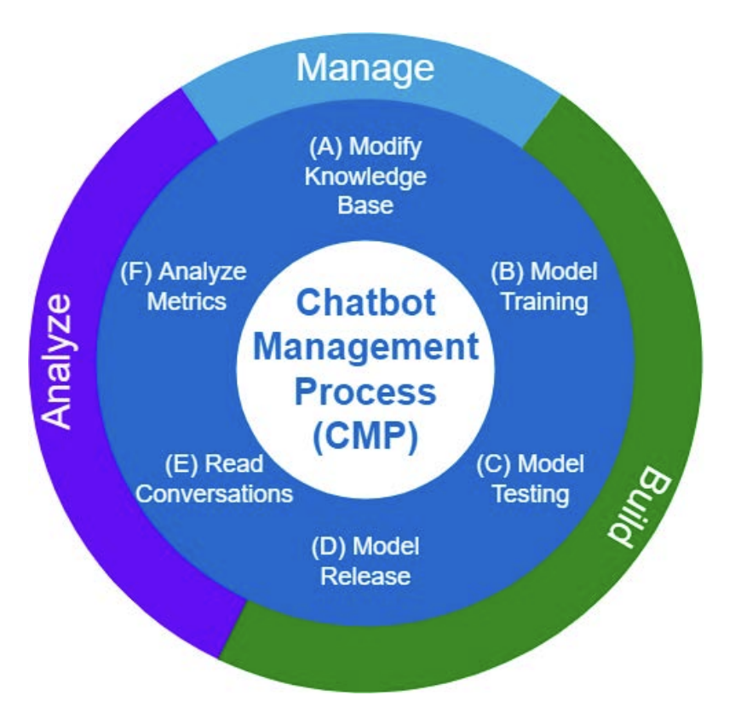
Literature Analysis
Common insights & approaches:
Conversational data as the main resource for the ongoing development of CAs
Development cycles that follow the CDD principle
Analysis of conversational datasets through systematic coding processes
Often focus on privacy concerns
Conversational data (pre-)processing
  Categorization of user input & agent responses
  Fallback responses / correctly assigned intents
Typical metrics
  User satisfaction based on feedback systems
  Number of users, (un-)successful conversations
A Conversation-Driven Approach for Chatbot Management (https://ieeexplore.ieee.org/document/9681834)

Slide 14


Literature Analysis
Unique approaches:
Google Home user study (complete in- and out-of-scope tasks with a CA)
  Rate of correctly understood questions (→ speech recognition)
  Metrics: Conversation turns per task, recovery efficiency
  Ensure common ground during conversations
  “Unrelated” responses (understood request, unhelpful response) are better than default fallbacks
Information Seeking Assignments
Symbiosis between people and digital assistants
+
The Role of Conversational Grounding in Supporting Symbiosis Between People and Digital Assistants (https://dl.acm.org/doi/10.1145/3392838)
Google Home (https://home.google.com/welcome/)

Slide 15
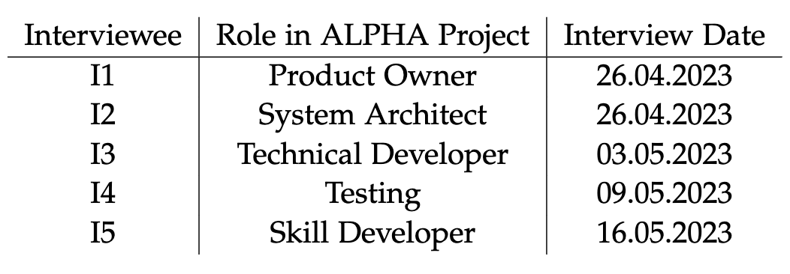
Semi-Structured Interviews
General notes:
Every interview was entered with the (at the time) current version of the visualization prototype to gather feedback and give an idea of the application
Depending on the role of the interview partner, the insights of the conversation were limited to how that person interacts and works with log data
However, the distinct roles also provided different points of view on how the data could be used

Slide 16






Semi-Structured Interviews
Commonly shared insights and ideas:
Display total users & users over time
Clear and sorted display of conversations
Evaluation of intent confidences
Latencies (webhook-response-time)
Extract problematic conversations

Slide 17
Semi-Structured Interviews
Concrete individual opinions & suggestions:
I1
Make use of (stacked) bar charts to display rich data
Display frequently and rarely occurred intents
Product Owner
I2
User Retention (usage over time of specific intents)
Conversation path trees
System Architect
Tech. Developer
Tester
I3 I4
Analyze the usage of the reminder system (medication/hydration)
Highlight initiator of conversations
User group prefers conciseness over verbose explanations
Analysis of ”active” users (vs. “passive” users)
Chronological skip buttons to display conversations in order
I5
Skill Developer

Slide 18
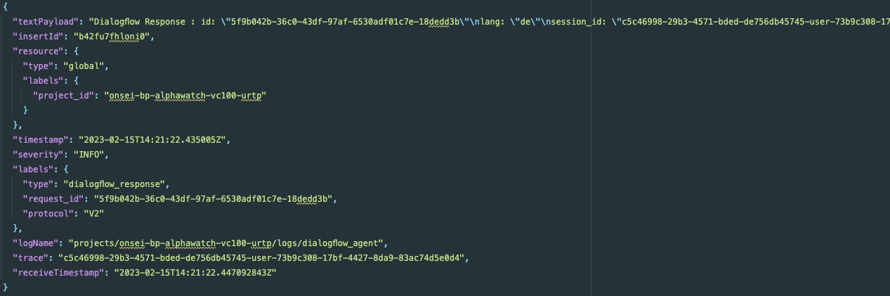
Log Data Analysis
Raw Dialogflow log data
  JSON structured files with 10k log entries (~55MB)
  Requests & Responses
Example Log Entry

Slide 19
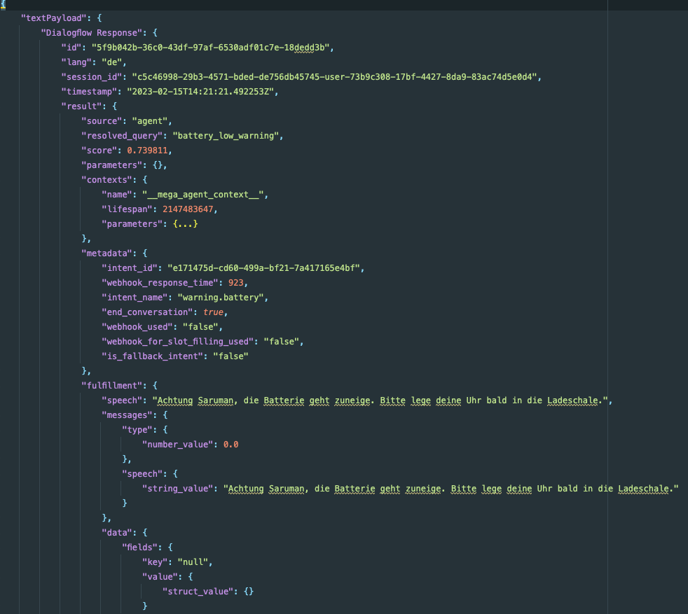
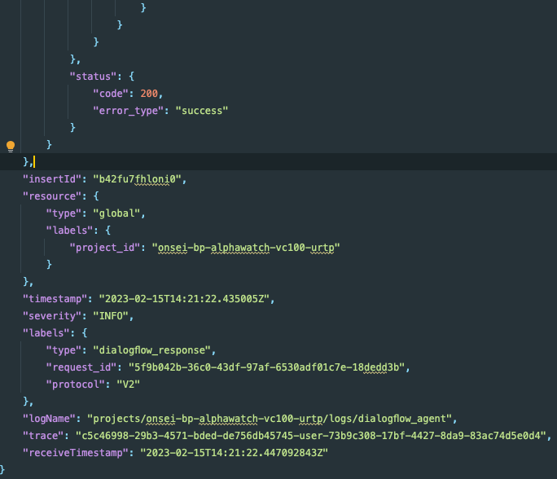
Log Data Restructuring
Restructured Log Entry

Slide 20
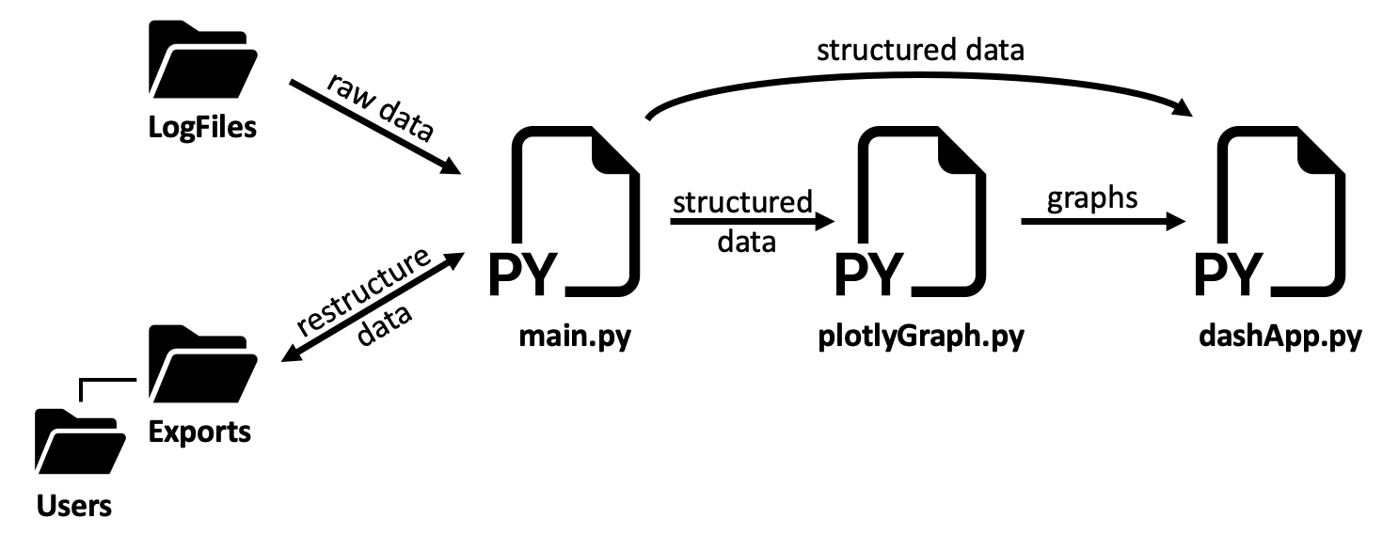
Log Data Extraction & Processing
Programming language: Python (prevalent data analysis language)
Standard library includes “json” package to work with JSON data
Two main restructuring features:
  Restructure the raw log file to a deeply reformatted one → reduced file size (~23MB)!
  Structure & sort the data based on User-ID & Session-ID
Use restructured data to analyze metrics & conversations

Slide 21


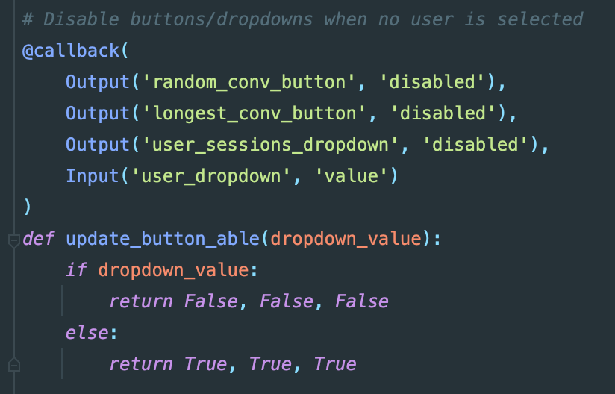
Data Visualization Dashboard Prototype
Framework: Plotly + Dash (open source)
  Stay within a Python project structure
  Follow “low-code” principle → Keep project structure simple and avoid “real” HTML, CSS, JS code
Dash “workarounds”
  Python-embedded HTML functions (<p> ≙ html.P(…))
  Interactivity realized through “callback” functions
  Flask for the web server architecture
Plotly (https://plotly.com/)
Flask (https://flask.palletsprojects.com/en/2.3.x/)

Slide 22
Data Visualization Dashboard Prototype
→ Final project structure
→ Deployed version on company servers

Slide 23
Outline
Introduction
  Motivation
  Technical Foundations
Research Approach
  Research Questions
  Methodology
Results
  Literature Analysis
  Semi-Structured Interviews
  Log Data Analysis and Visualization
Improvement Suggestions
Conclusion

Slide 24
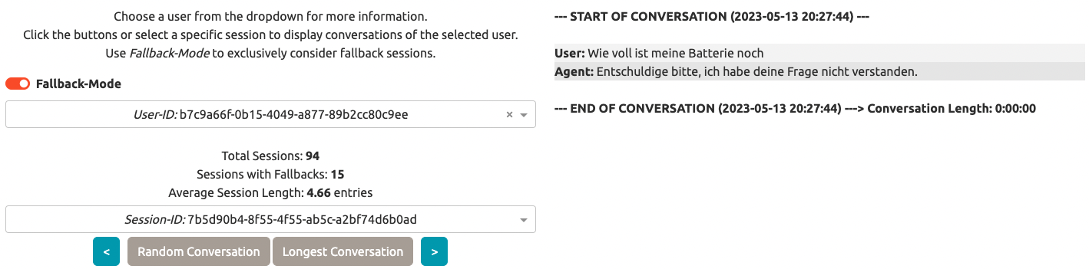
Improvement Suggestions
RQ3
Prepare “fix” phase of the CDD cycle
Unanticipated user behavior
Unveils missing functionality (only proactive battery warning intent implemented)
→ Add new intent that allows user to ask for the battery status

Slide 25
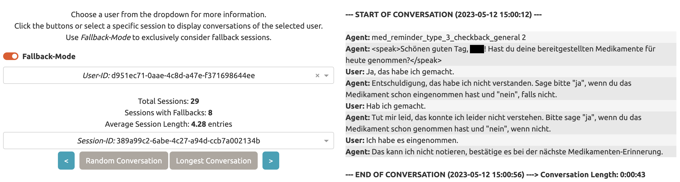
Improvement Suggestions
Confirmation misunderstanding
Agent expects “yes” or “no” answer, cannot comprehend worded formulation
→ Extend confirmation possibilities to allow for more wordy formulated responses

Slide 26
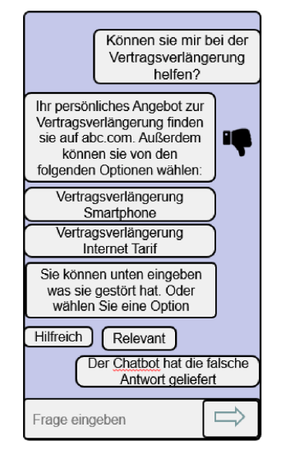
Improvement Suggestions
Inspiration from literature: instant feedback system
Identify problematic conversations even faster (not all conversations with fallback occurrences “failed”)
Comprehend the reason for users’ frustration
Calculate user satisfaction
Option to ”tag” a conversation as unsuccessful/unhelpful at the end of it
Avoid rating on a scale (too verbose, might demotivate its usage)
The Potential of Chatbots: Analysis of Chatbot Conversations (https://ieeexplore.ieee.org/document/8808076)

Slide 27
Outline
Introduction
  Motivation
  Technical Foundations
Research Approach
  Research Questions
  Methodology
Results
  Literature Analysis
  Semi-Structured Interviews
  Log Data Analysis and Visualization
Improvement Suggestions
Conclusion

Slide 28
Conclusion
Dissection of CAs (literature, interviews, data analysis & visualization, improvement suggestions)
→ Dashboard is deployed to company servers
Limitations
  Limited to information available in logs (no power consumption / geo-tracking)
  Time constraints (prototype features)
Future Work
  Integrate database system
  Support multiple/larger log files (more insights)
  Connect analytics to user data (medicinal, geographical)
  Automate new log file integration

Slide 29
Nicolas Klein
17132
matthes@in.tum.de

Slide 30
Appendix

Slide 31



Motivation
Potential for a conversational agent (CA) to aid with daily tasks in the geriatric care domain
Conversational interfaces require very little technical know-how to operate them
Fitting technology for the discussed application domain
Lack of scientific studies (elderly community + CAs)
Types of CAs:
Text-Based: Conversations in the form typed chat messages (Chatbot)
Focus of this work
Voice-Based: Conversations in spoken natural language with a synthetic voice
Embodied: Conversations with a physically/digitally embodied agent

Slide 32
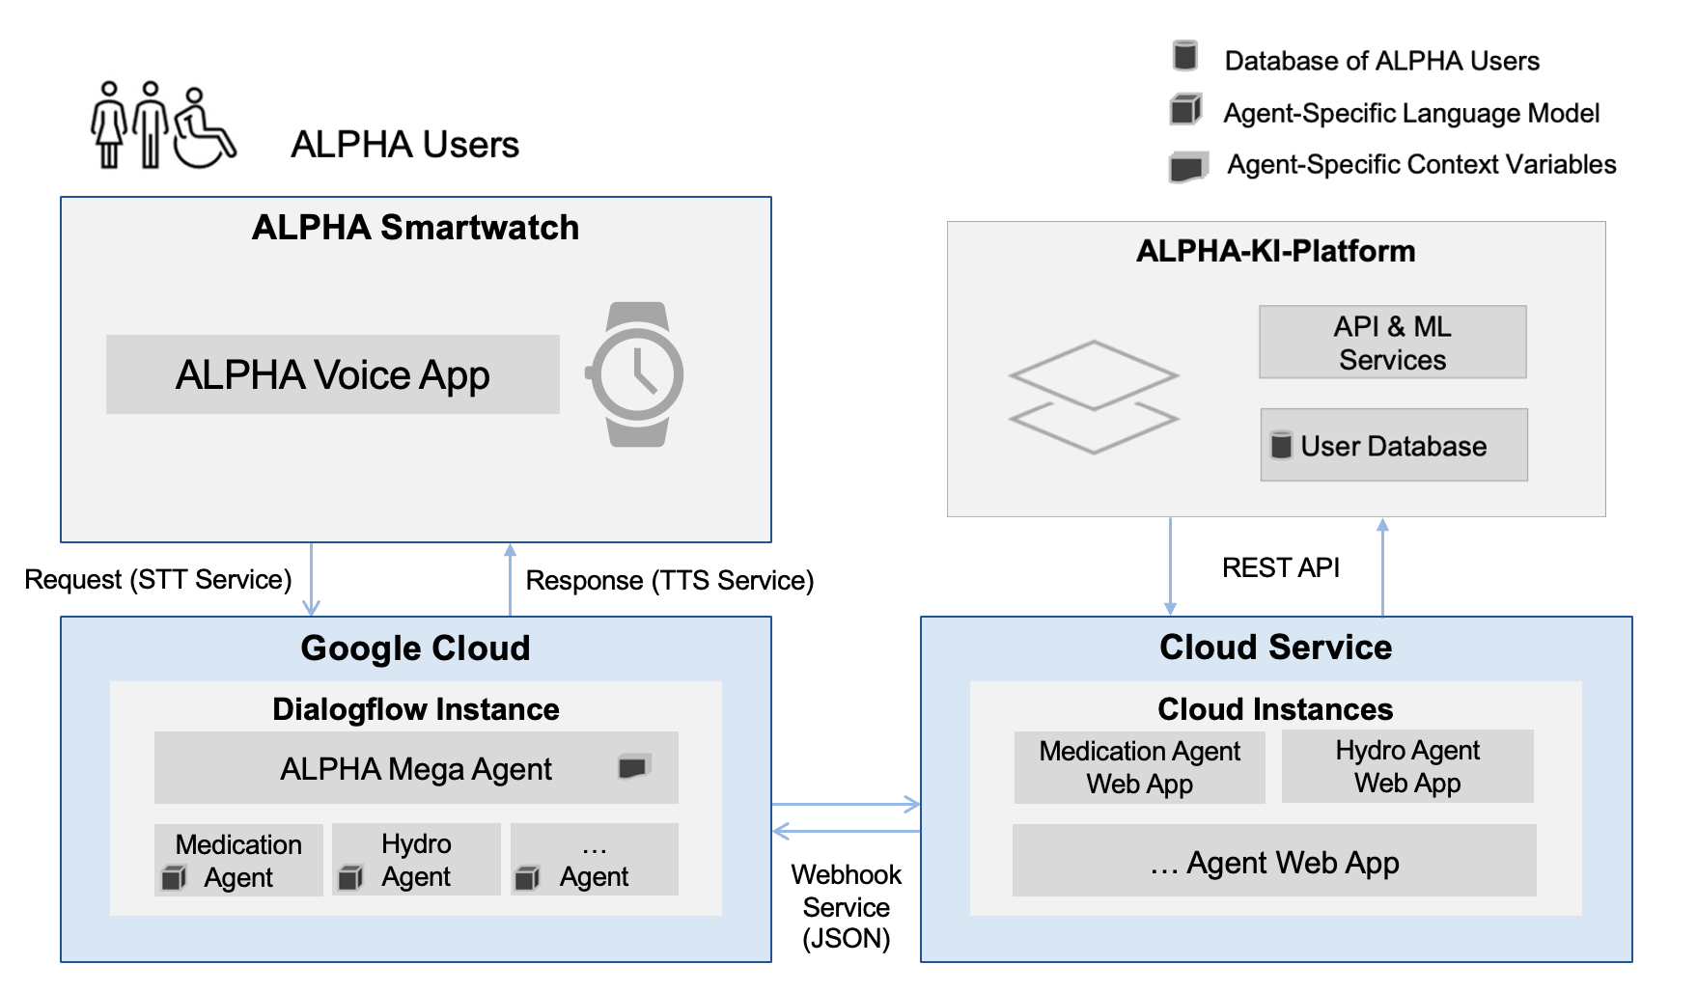
ALPHA Architecture

Slide 33
Literature Analysis
Search in: Title, Abstract, Keywords
Full Search String:
  ("Conversation Analytics" OR "Conversation Data" OR "Conversational Data" OR "Conversational Analytics" OR "Dialog Analysis" OR "Conversational Analysis" OR "Conversation Analysis" OR "Conversation Driven Development" OR "Conversational Dataset" OR "Dialogue Analysis" OR "Conversation Exploration") AND ("Chatbot" OR "Conversational Agent" OR "Chat bot" OR "Voicebot" OR "Voice bot" OR "Conversational Interface" OR "Dialog System" OR "Digital Assistant" OR "Virtual Assistant" OR "Conversational Assistant" OR "Voice Assistant" OR "Conversational System”)

Slide 34
Semi-Structured Interviews
Question Catalog: Loose orientation for questions to be asked; split into two parts
Usage, analysis, and relevant metrics of log data:
  Significance of user data?
  Interesting metrics with reference to the user group?
  Influence of user data on the ongoing development of ALPHA?
Data visualization (development & design):
  What metrics require vivid visualizations?
  What types of visualizations are most useful?
  What interaction possibilities should be part of a data visualization application?

Slide 35
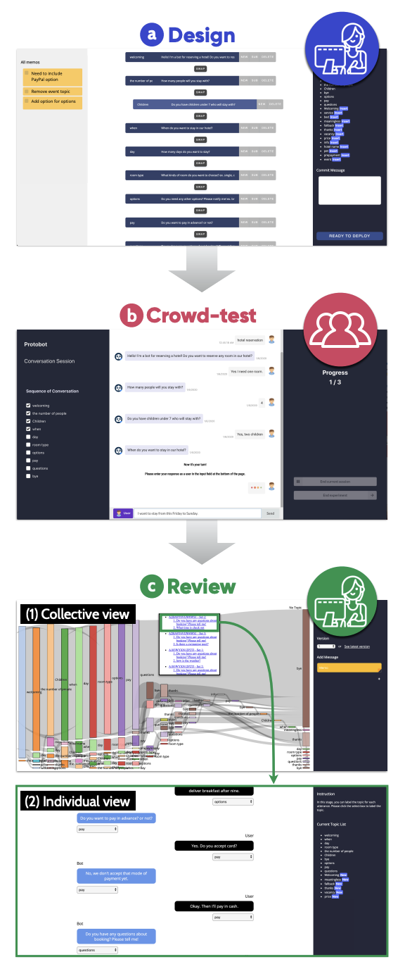
Literature Analysis
Unique approaches:
ProtoChat: Assist conversation designers to plan, build, and test conversation flows
Two visual interfaces (designer & crowd-test)
Crowd-testing platform to collect initial conversation data
Sankey diagram to visualize conversations
  Understand common topics/intents of the agent
  Display example conversations
Supporting an Iterative Conversation Design Process (https://dl.acm.org/doi/10.1145/3334480.3382951)

Slide 36
Semi-Structured Interviews
More opinions & suggestions:
I1
Length of interactions (turns & time)
No specific numbers in relation to the user group
Product Owner
I2
Analyze “low” intent confidences (where is the threshold?)
Compare failed vs. successful user utterances
System Architect
Tech. Developer
Tester
I3 I4
Analyze long delays (→ Internet connection issues?)
Inspect failed conversation flows (→ evaluate agent reliability)
I5
What utterances trigger the default fallback intent?
Inspect conversations with low intent confidence scores
Skill Developer

Slide 37
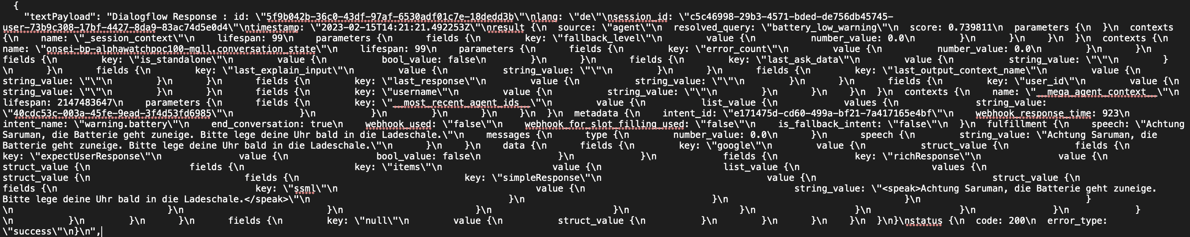
Log Data Analysis
Example Text-Payload
Text payload contains a lot of relevant information which needs to be extracted
  But: Payload format is in HOCON (JSON superset)
Implementation of own parser / usage of an existing parser (“Pyhocon”)
  → New & deeply reformatted JSON log files
Pyhocon parser (https://github.com/chimpler/pyhocon)

Slide 38
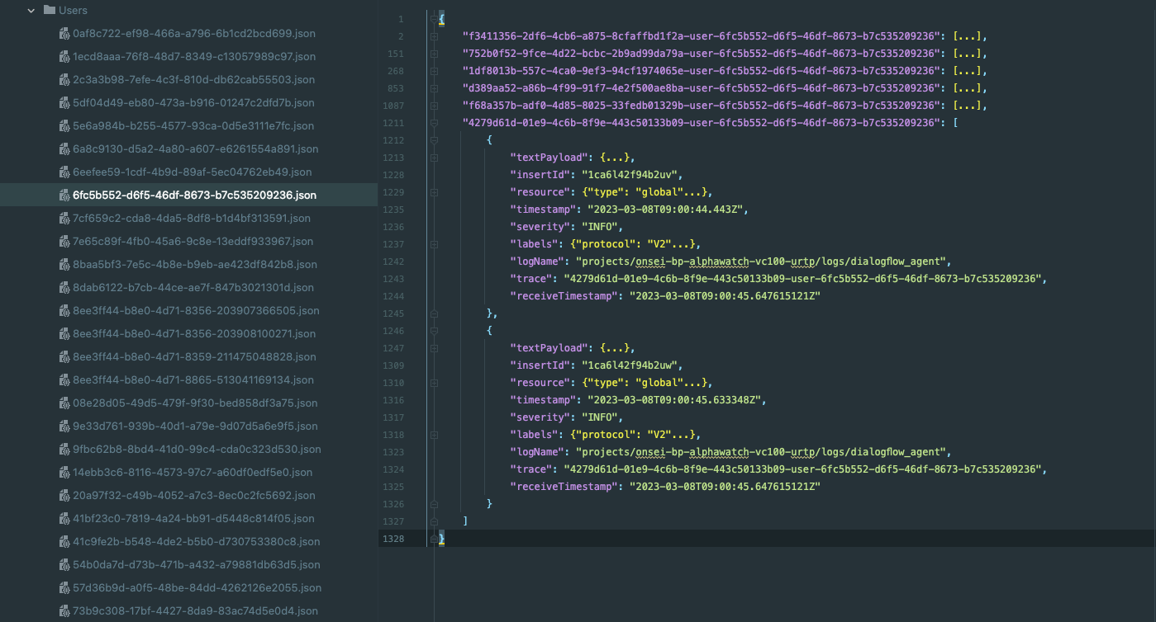
Log Data Restructuring (2)
One JSON log file per user (User-ID → filename)
Entries
  Key: Session-ID
  Value: List of chronologically sorted log entries of the session
Session-ID
log entry
User-ID
→ User specific data & clear conversation flow overview

Slide 39
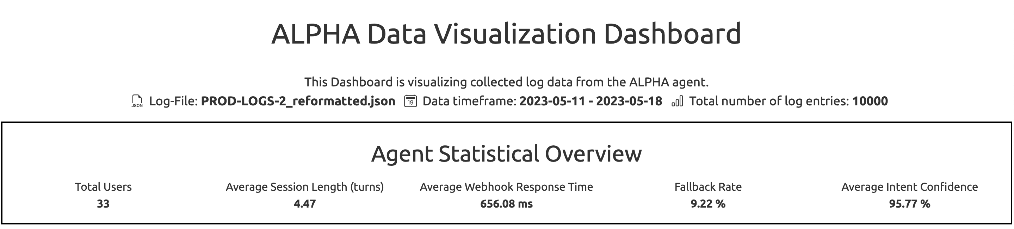
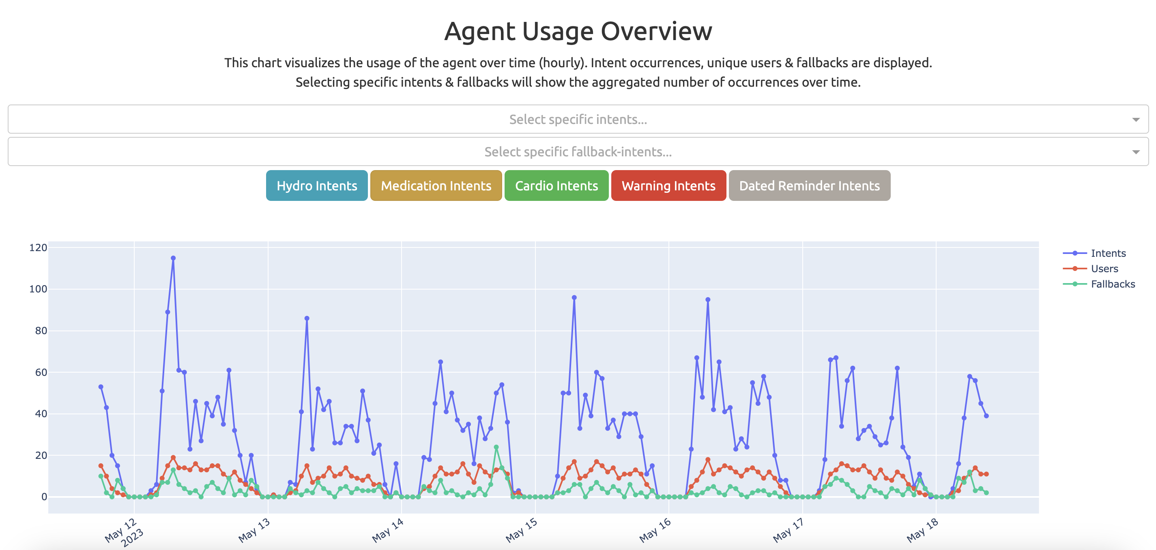
Data Visualization Dashboard Prototype

Slide 40
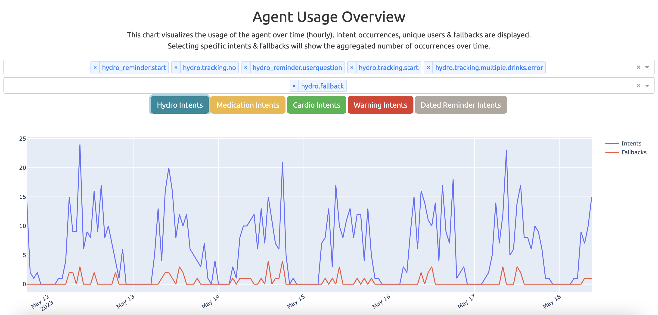
Data Visualization Dashboard Prototype

Slide 41
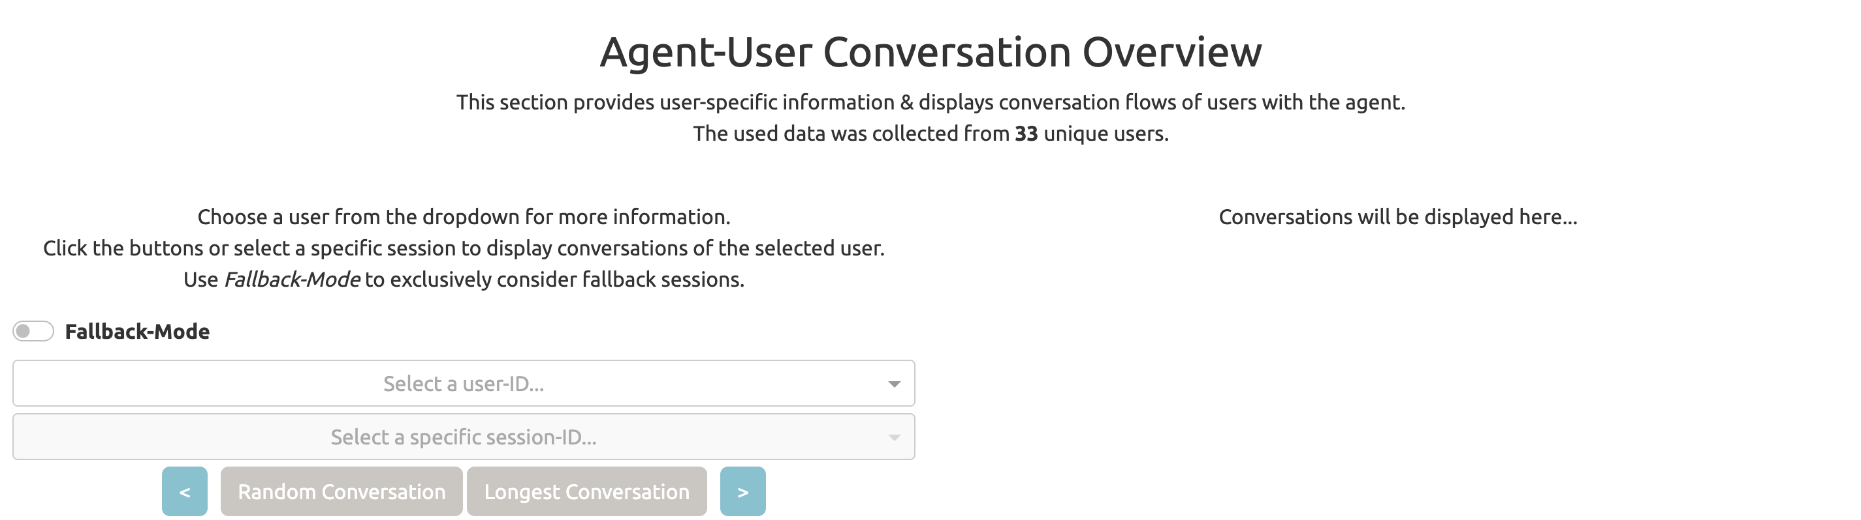
Data Visualization Dashboard Prototype

Slide 42
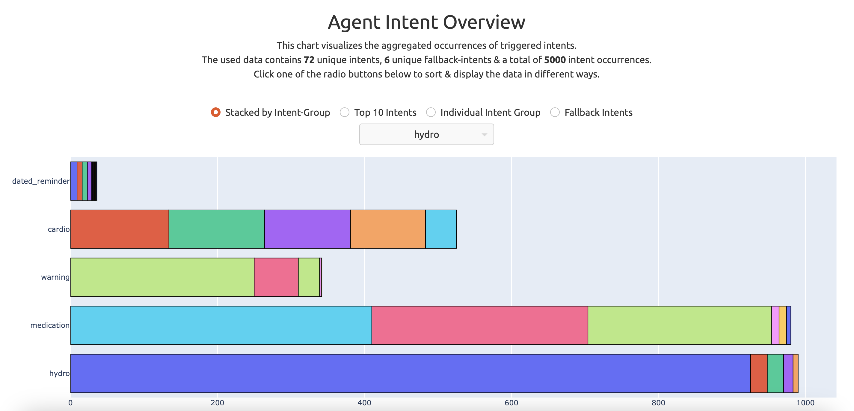
Data Visualization Dashboard Prototype

Slide 43
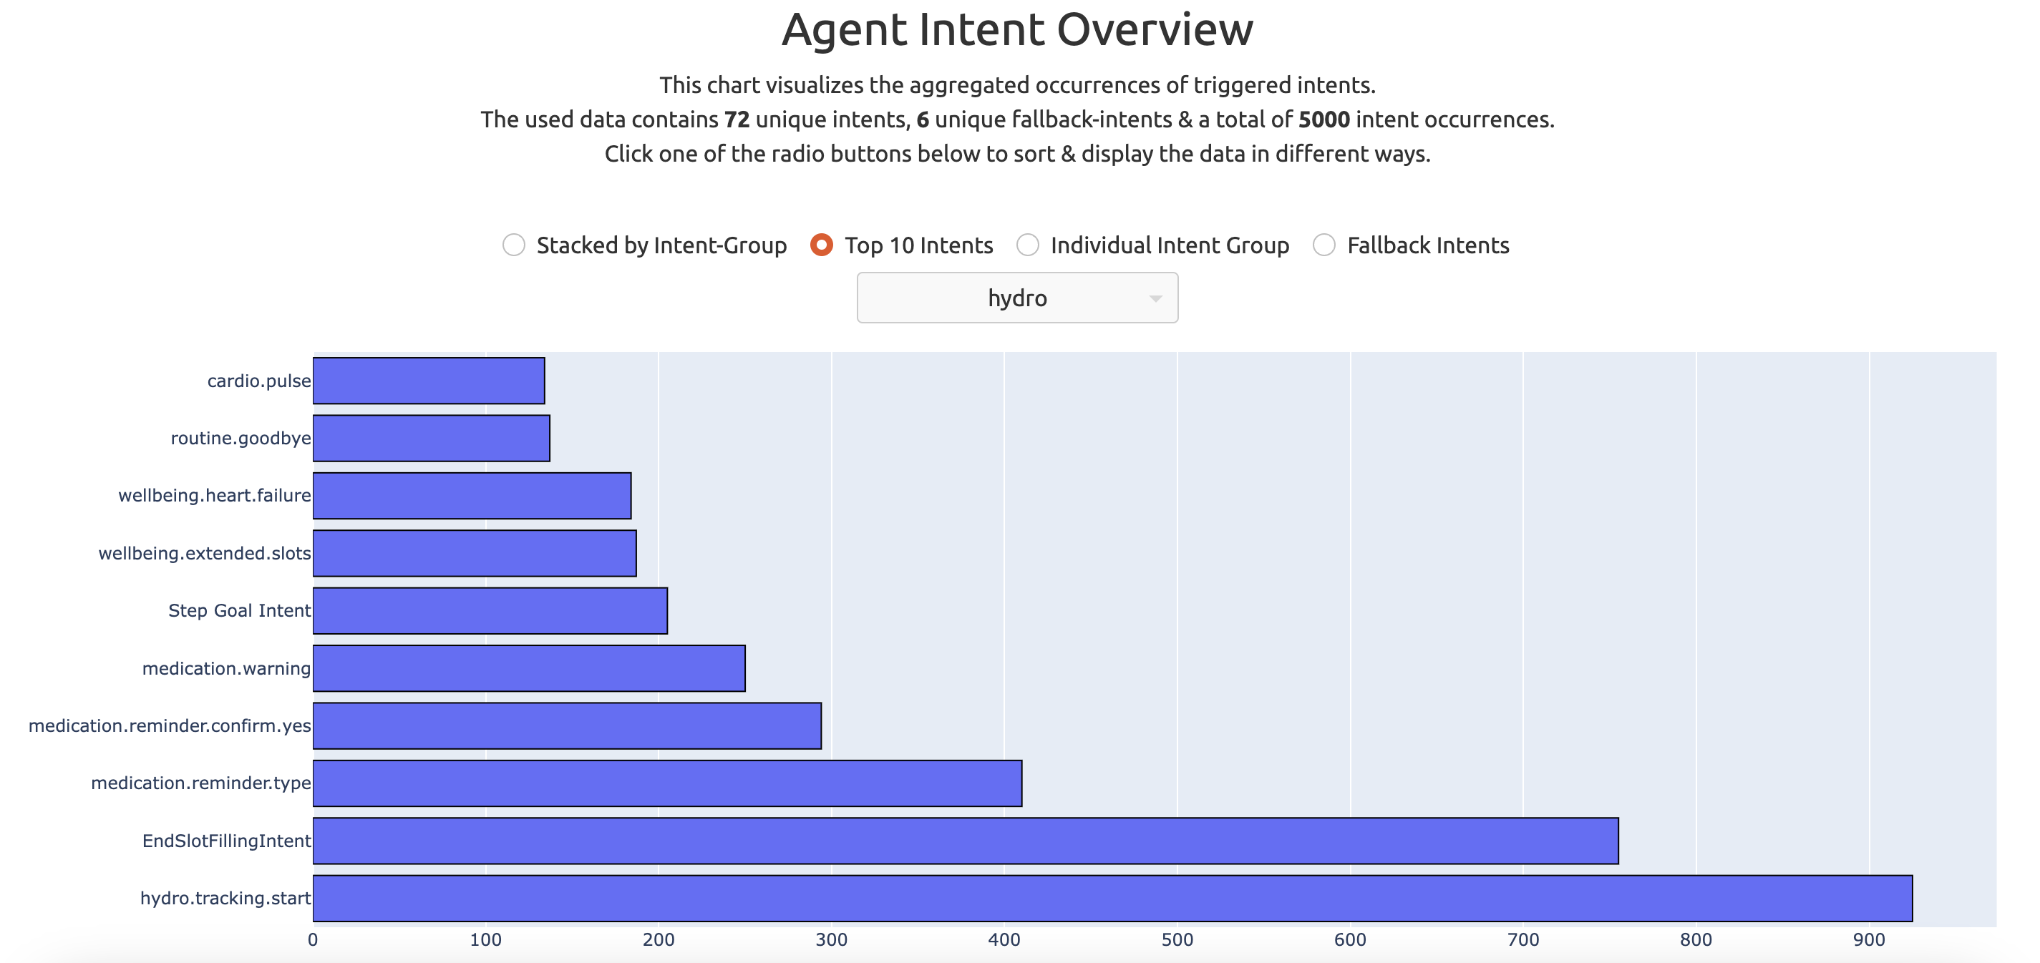
Data Visualization Dashboard Prototype

Slide 44
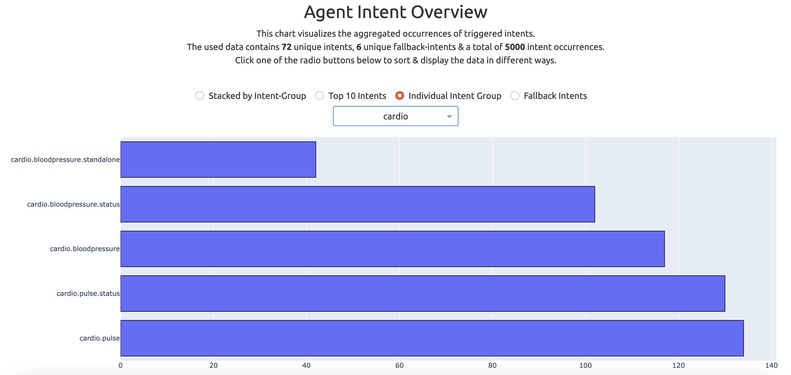
Data Visualization Dashboard Prototype

Slide 45
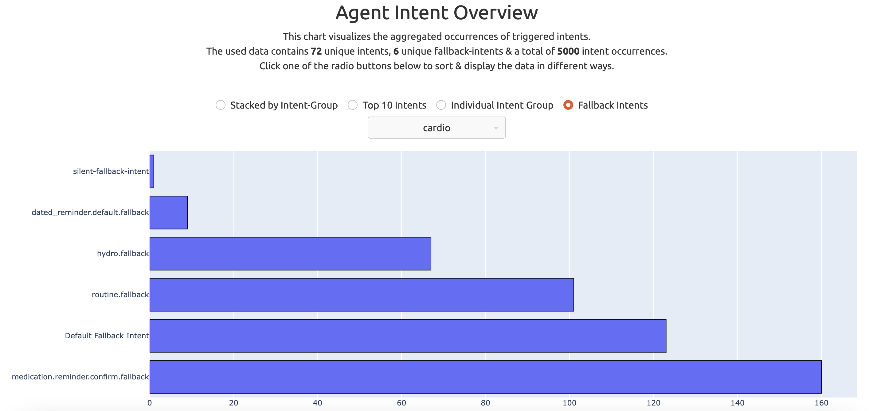
Data Visualization Dashboard Prototype

